Slide 1
A Startup Strategy Plan And Its Visualizations
Presented by Nithyashree S
TOP MENTOR

Slide 2
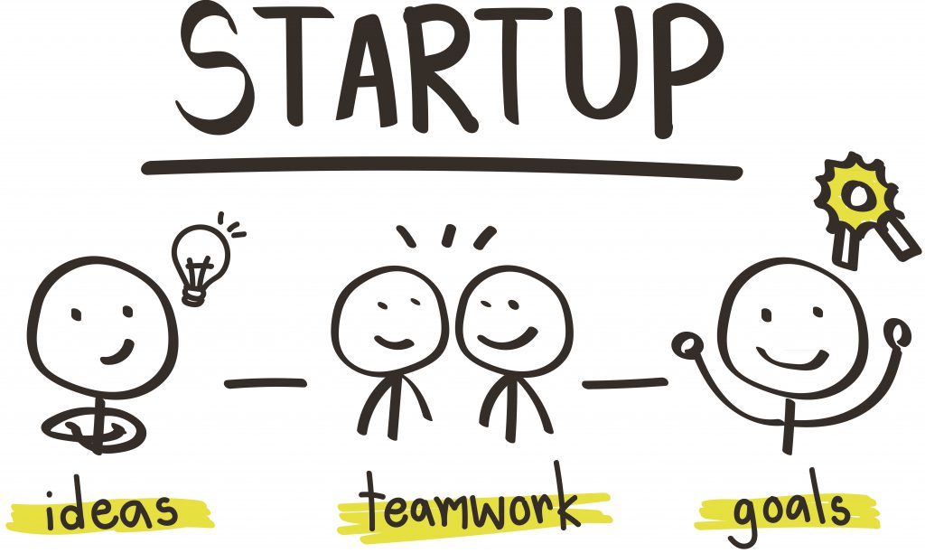
A STARTUP STRATAGY PLAN
A startup is a young company founded by one or more entrepreneurs to develop a unique product or service and bring it to market.
TOP MENTOR

Slide 3
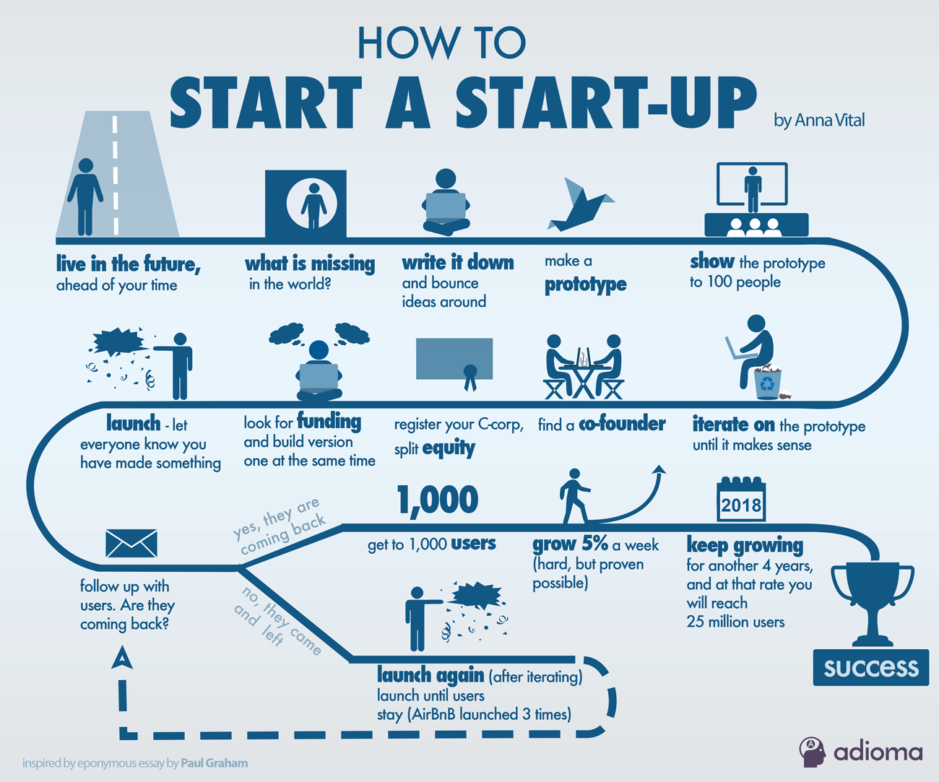
Initial steps to start a startup
TOP MENTOR

Slide 4
Steps in building a successful startup
Come Up With an Enriching Idea.
Do Some Market Research.
Prepare the Business Plan.
Build Your Team.
Incorporate Your Business.
Look Out for Funding.
Set Up the WorkSpace.
Work On Sales & Marketing Strategies
TOP MENTOR

Slide 5
After idea development it looks for funds from different investors
Self Funding
Seed-Capital
Venture
Series A
Series B
Series C
IPO(Initial Public Offering)
TOP MENTOR

Slide 6
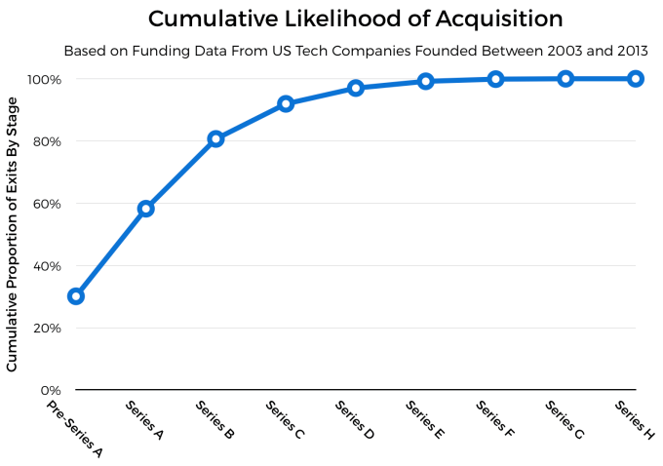
An Example of how Funds Related to sales
TOP MENTOR

Slide 7
The first stage of funding your startup is bootstrapping. With bootstrapping, you’re using existing resources. In the sense of funding a startup, you take your own funds and abilities and begin to support what you can of your startup.
The second stage of funding iscrowdfunding.
Crowdfunding gives your friends, family, and social media followers a chance to help support what it is that your startup does.and which intern is a part of seed capital.
TOP MENTOR

Slide 8
The next stage involvs following…
Common terms you may also hear are series A, series B, and series C.
Series A is the first round of stock offered to investors during the early days of business.
Series B is a second stage of financing. It happens after a startup has met certain goals and shown that it is viable. Sometimes, it is known as a venture round.
Series C is an additional round of funding. Basically, any future rounds of funding generally go alphabetically down the line.
TOP MENTOR

Slide 9
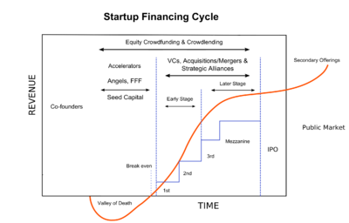
Venture captital and revenue
TOP MENTOR

Slide 10
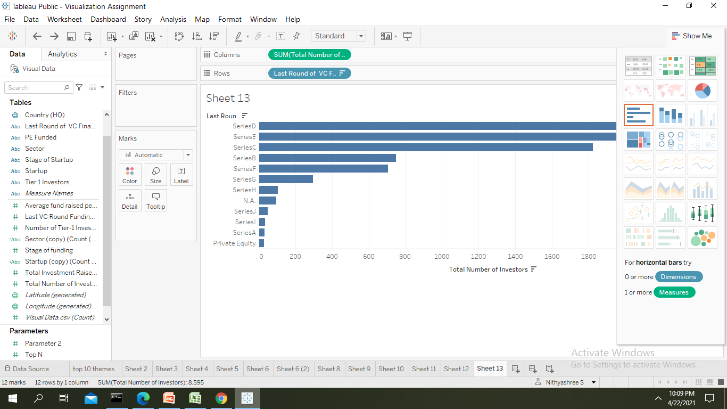
Number of investors and there VC financing
TOP MENTOR

Slide 11
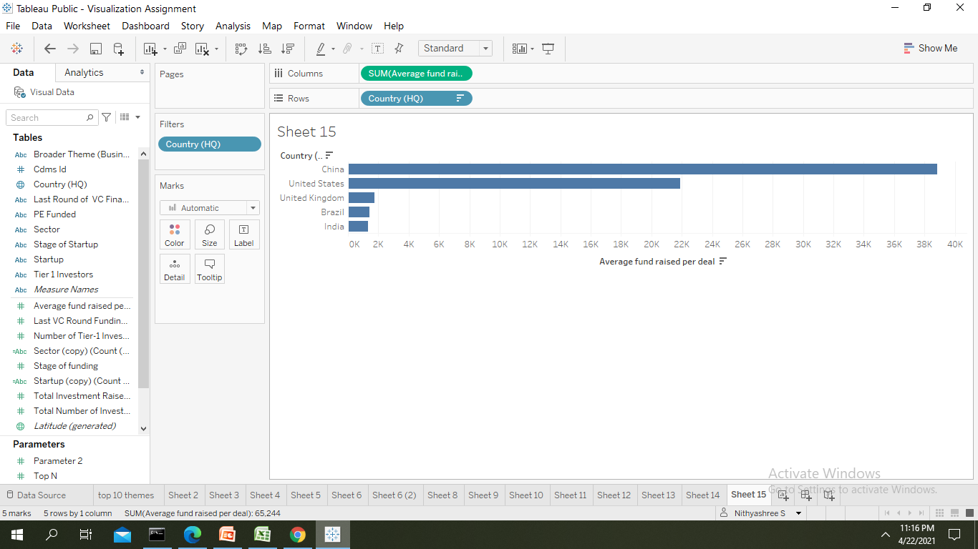
The Top Five Countries And Their Average Fundings
TOP MENTOR

Slide 12
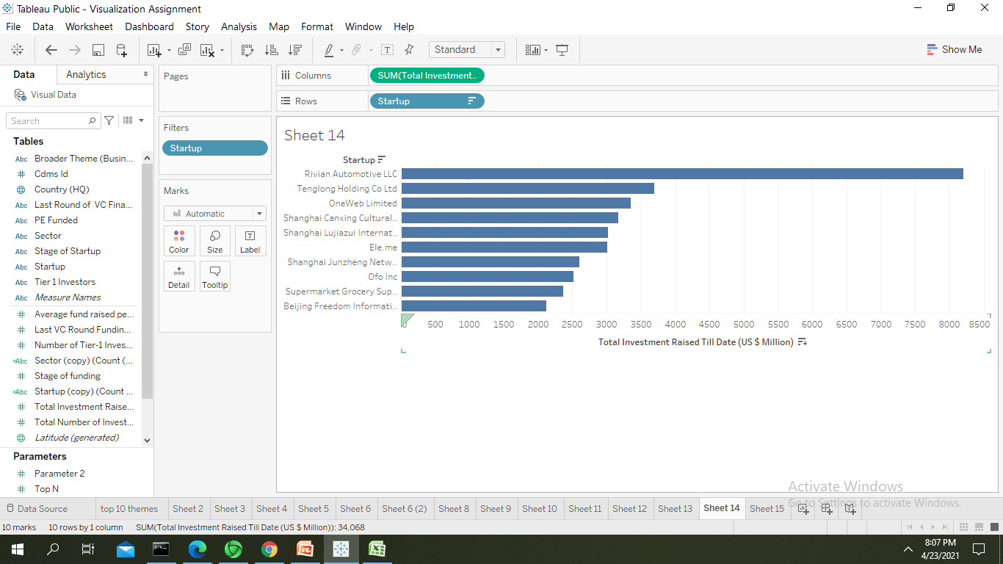
Startup companies and the investments
TOP MENTOR

Slide 13
Building and developing POC
The main thing in developing the visualization is the collection of data where major time accomplishes.
After aquiring data the data needs to be cleaned in a structured way which we had got in a raw form.
After cleaning data needs to be analysed and needs to find the hidden insights from the data.
After the analysis the data needs to be visualized using different visualization tools like Excel,Tableau etc…
Collection of data along with cleaning=months together
Analysis=1 week
Visualization=takes less time within days
TOP MENTOR

Slide 14

TOP MENTOR

